Slide 1


Instrument Independent Reduction and Analysis
at ISIS and SNS
Nick Draper
Tessella

Slide 2
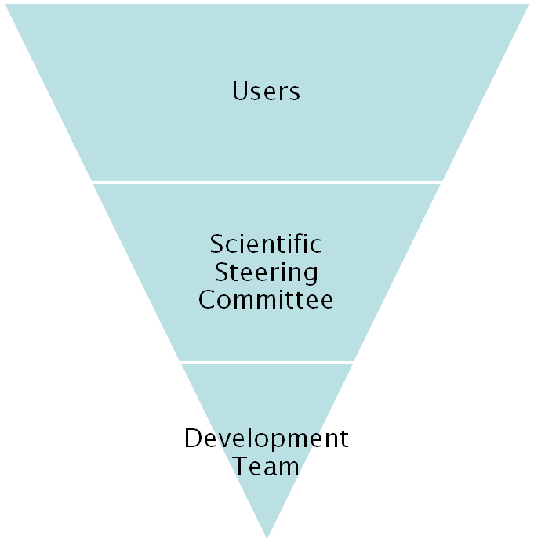
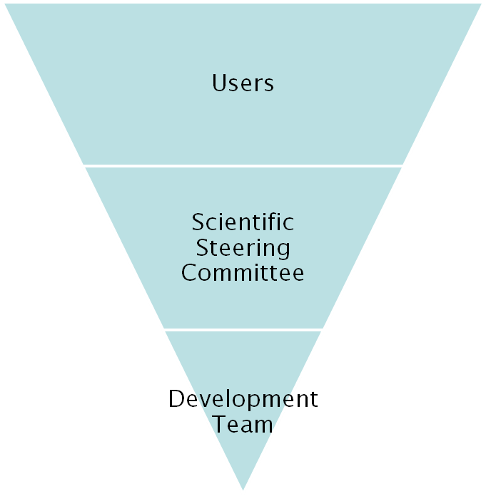
Project Organisation
ISIS
SNS/HIFR
27 beamlines, 1600 users
26 beamlines, 850 unique users
9 Key scientists
4 Key scientists
PM &
16 Developers
Project Management Board

Slide 3
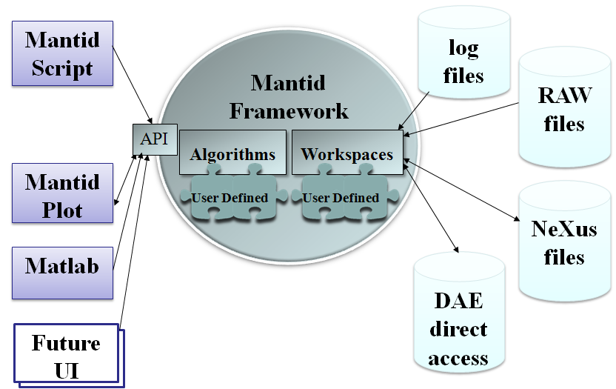

How we do it Technically
Organisation
  Open source
  Continuous integration
  Automated build, test & deploy
  Distributed team
C++ Framework
  Win, Linux, Mac
  Memory Management
  Performance optimisation
    OpenMP
  Common Interfaces
  Plug in Mechanism
ICAT
Qt GUI
  Extended from QtiPlot
Python Scripting
  Using Boost Python
  Powerful and extensive coverage
  Integration with NumPy

Slide 4
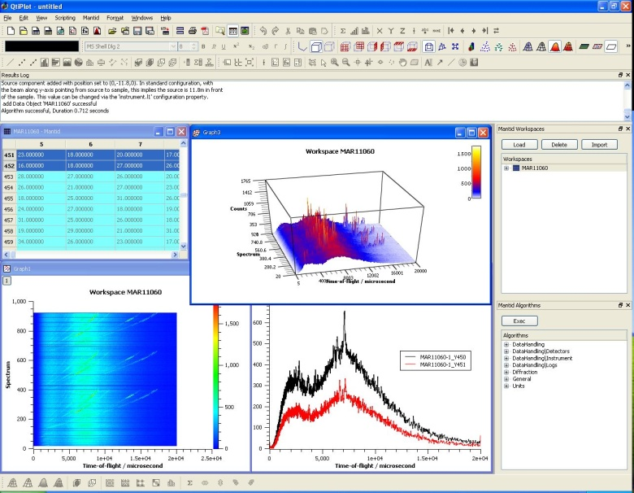
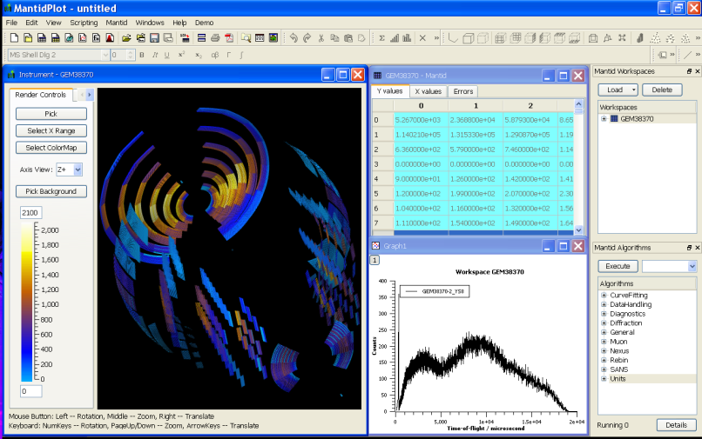
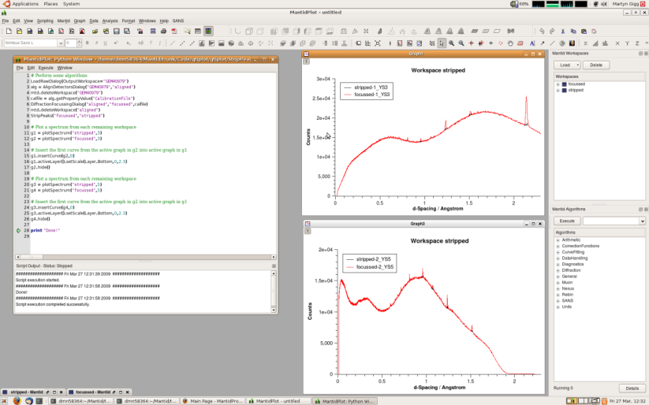
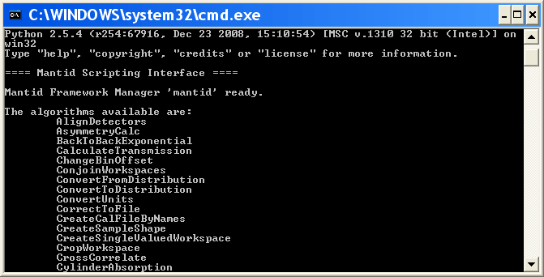
User interfaces
MantidPlot
  1, 2 and 3D plotting
  Interactive Instrument view
  Ad hoc analysis
  Specific User interfaces
  Integrated scripting
  Extendable with plugins
MantidScript
  Pure command
  line support

Slide 5
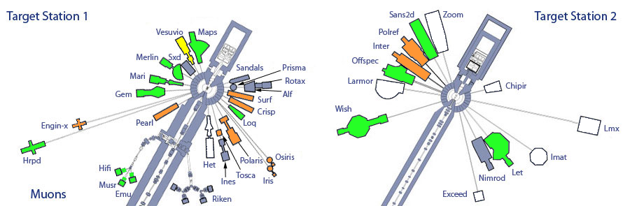
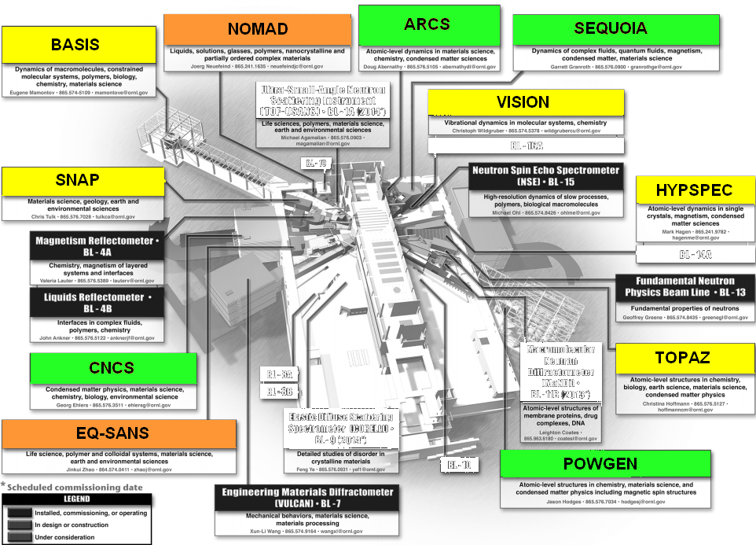
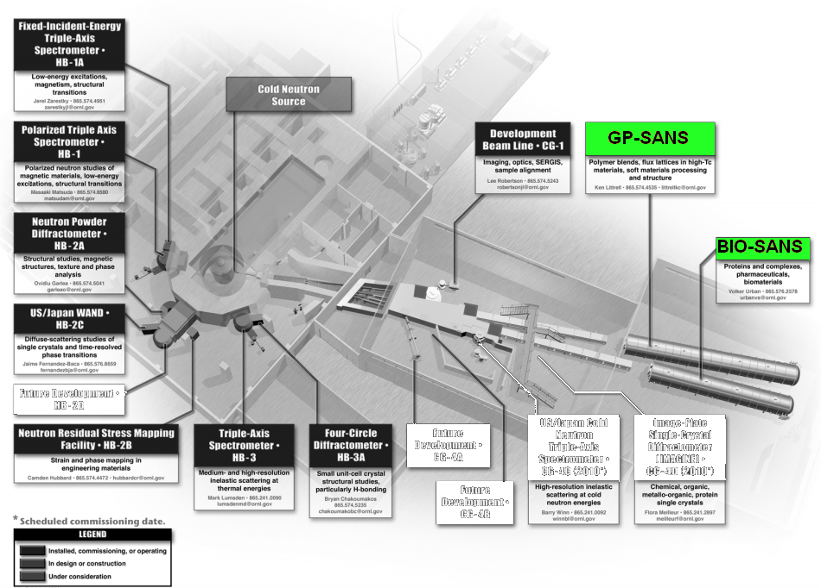
Rollout
ISIS
In
Use
Under Evaluation
Active Development
SNS
HFIR

Slide 6
Challenges
Documentation
  User
  Developer
Large distributed team
  Communication
  Direction
Rapid development vs refactoring
Weaknesses in third party components
  Visit vs Paraview
No two facilities are the same
  Archive structure
  Information catalog
No two instruments are the same
  Workflow differences

Slide 7
Future tasks
Absorption correction improvements
  Total scattering
  Complex sample environments
Multiple frequency data analysis
Event based Rollout at ISIS
VATES
  100GB + data sets
  Multiple dimensions of interest
  Single Crystal & Diffuse Diffraction
  Quantitative analysis of 3D and 4D data

Slide 8


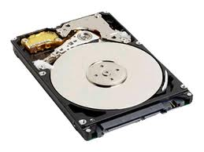
VATES - Advanced visualisation
Problem
  Large 100GB datasets
  4+ dimensions
    Q(x,y,z), ω, temp, field, etc.
Solution
  Distributed Parallel visualization
    Paraview
  On the fly parallel data rebinning
DataFile
Your Laptop
Rebinning+Visualization
Servers

Slide 9
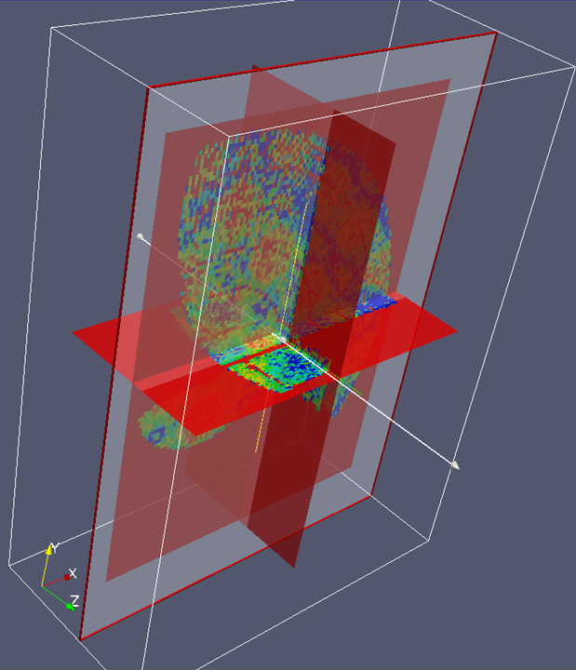
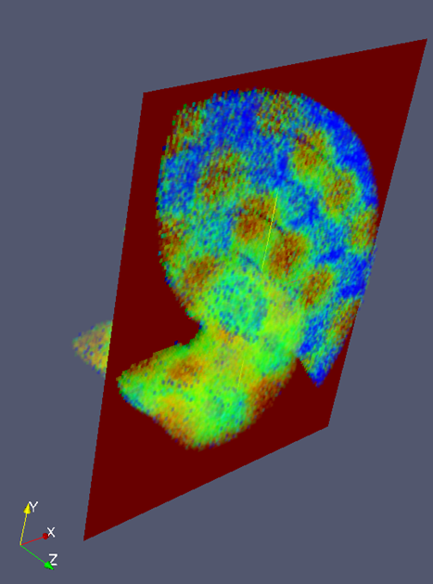

Multidimensional data visualisation

Slide 10
Further Information
Project Web Page
  www.mantidproject.org
Project Introduction Document
  http://svn.mantidproject.org/mantid/trunk/Documents/Requirements/Project%20Introduction%20Document.doc
User Requirements Document
  http://svn.mantidproject.org/mantid/trunk/Documents/Requirements/URD.doc
Architectural Design Document
  http://svn.mantidproject.org/mantid/trunk/Documents/Design/Architecture%20Design%20Document.doc

